Slide 1
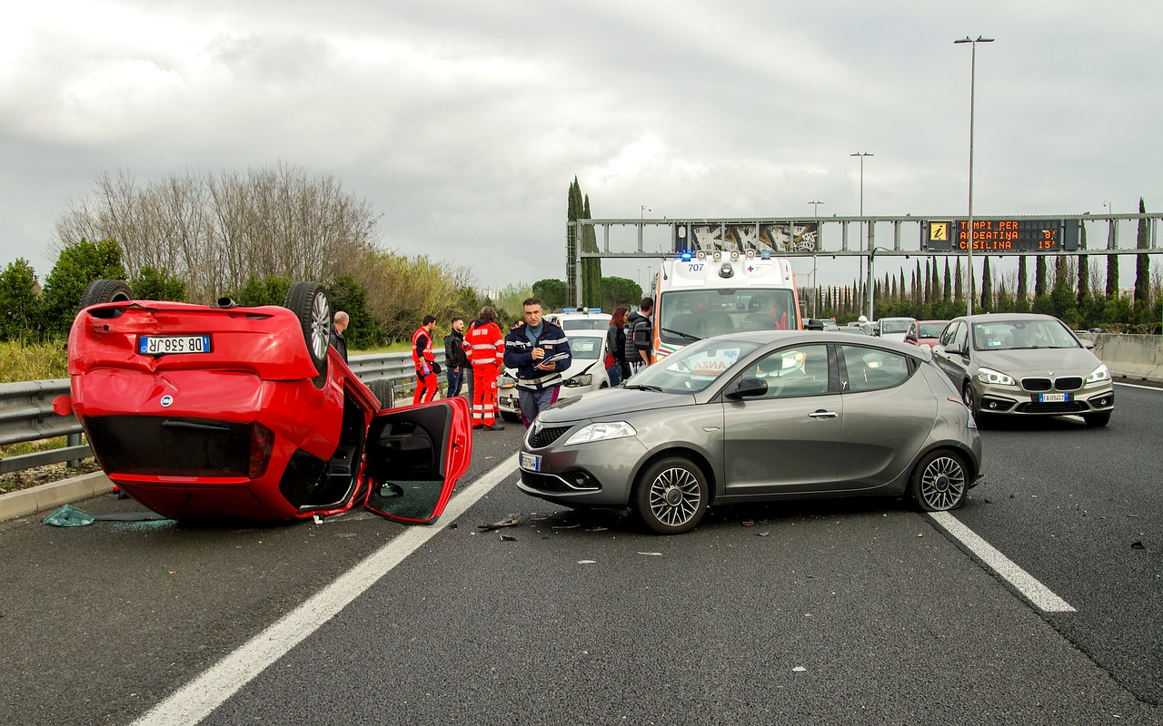
Analysing the Serious traffic accidents in the Greater Toronto Area
Project milestone 3
The audiences are including Canadian policy makers from traffic department.

Slide 2



Introduction
This presentation intends to analyze KSI (Killed or Seriously Injured) collision events from three aspects: time, location, and environment. As well as introducing key findings and recommendations.
The audiences are including Canadian policy makers from traffic department.
The dataset contains all date, time, location of KSI collision events (The KSI data only includes events where a person sustained a major or fatal injury in a traffic collision event) happened from 2006 to 2021 around GTA
Group information:ZAA.2231 10 Sepehr Salehi, Roohalah Taraf, Rongzhao Yi and Conghan Zheng

Slide 3
KSI in Different Time Frames

Slide 4
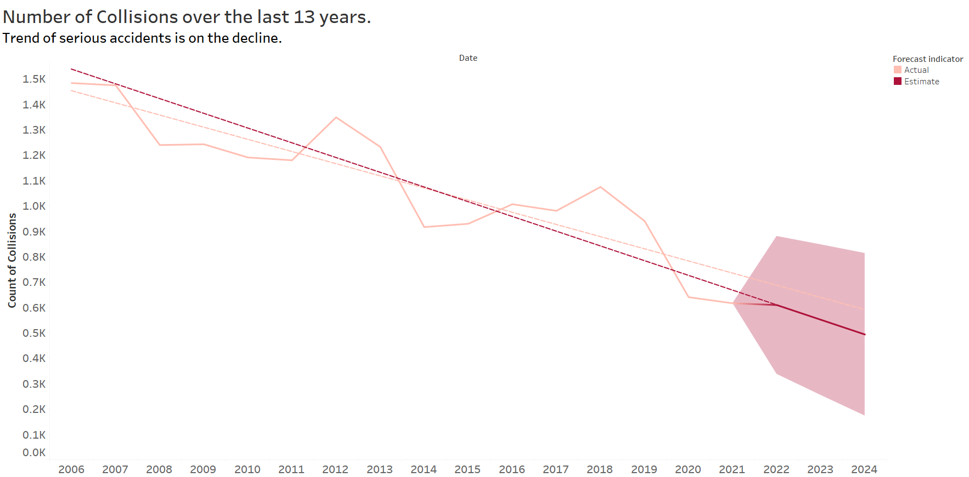
The KSI is on decreasing However to escalate the decline we need narrow down on more critical times.

Slide 5
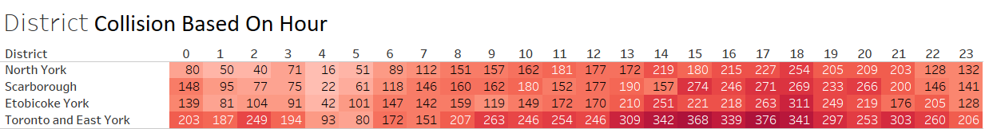
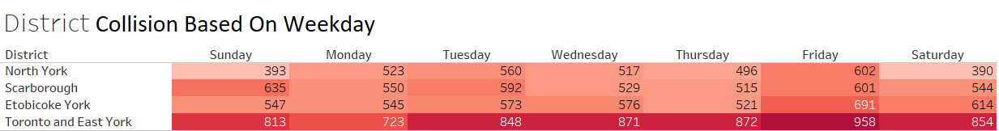
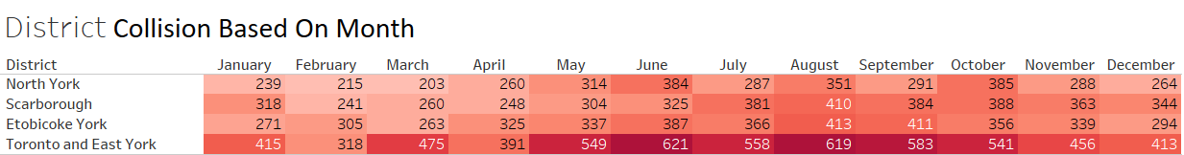
Toronto and East York police District needs to increase its police patrols on June and August Fridays From 2 to 6 PM.

Slide 6
Key findings and recommendations on KSI in Different Time Frames
The KSI is on decreasing However to escalate the decline some divisions need take more specific actions on special times.
Base on provided heatmaps during 14 to 18 has the highest rate of accident occurrence which more patrol police.
When analyzing days of week Fridays have more collisions which can be due to day before weekend traffic.
Summertime is most likely to have serious accident.
Police can increase drives awareness regarding this critical time frames to be more careful.

Slide 7
KSI in Different Locations

Slide 8
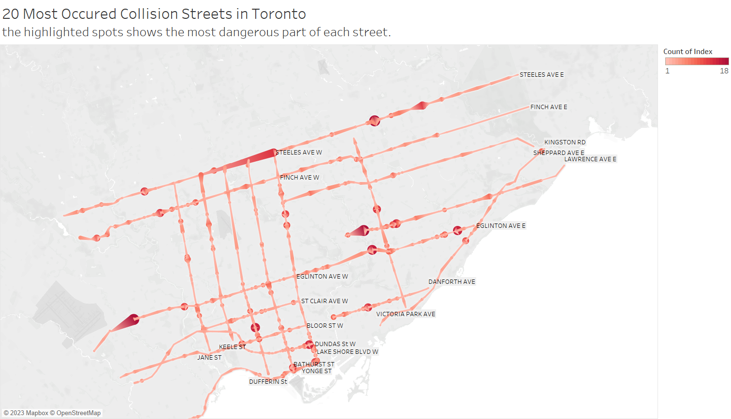
These dangerous spots are in need of Constant Monitoring

Slide 9
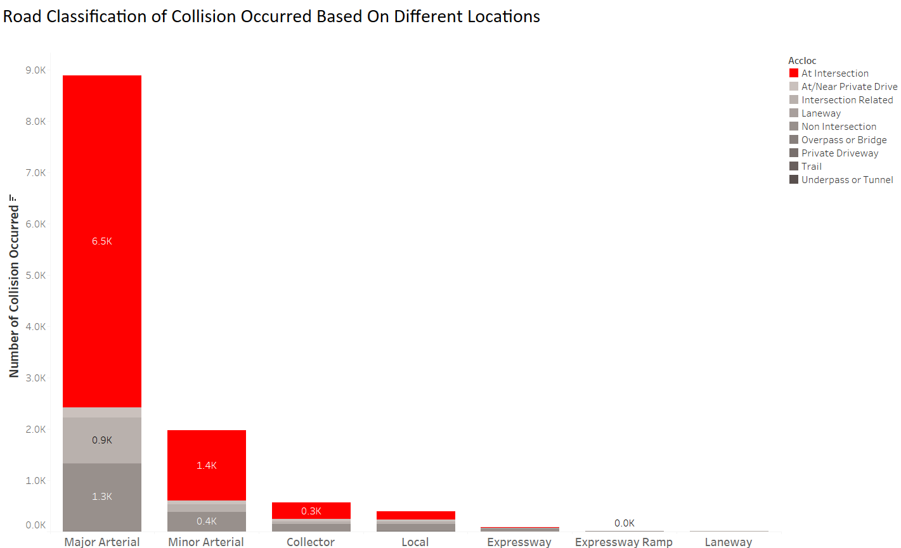
Intersections at Major Arterial Road are critical places

Slide 10
Key findings and recommendations on KSI in Different Locations
The most dangerous street and spots are identified by Toronto map. This locations needs more observations to find out the reason behind being dangerous of course each spot should be analyze one by one.
At Intersections and Major Arterial most collisions have accrued and the combine of these locations are the most dangerous places when driving. New set of equipments including installation new stops signs and lights need to be done to tackle this issue.

Slide 11
KSI in Different Environment Condition

Slide 12
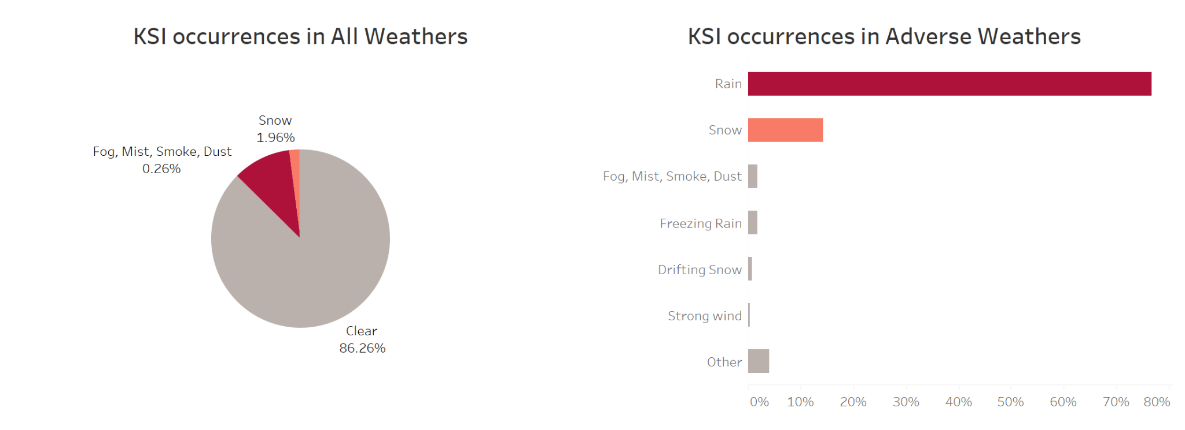
About 14% of KSI events caused by weather-related factors, rain and snow are the most common ones.

Slide 13
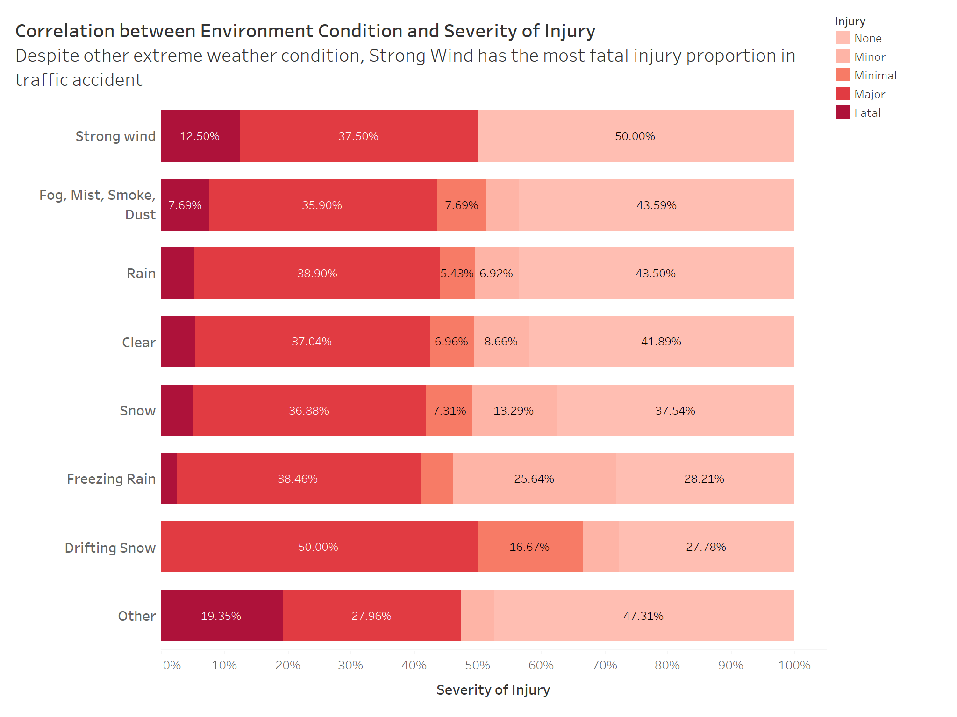
Environment Condition
Strong Wind has the most fatal injury proportion
Drifting Snow does not have fatal injury, but it has most Major Injury proportion
Fatal Injury and No Injury are both in descending order

Slide 14
Key findings and recommendations on Environment Condition
In strong wind condition, drivers may not drive as cautious as other extreme weather.
Those weather that has more probability of cause no injury are also more likely to cause a fatal injury as well.
In adverse weather conditions, rain tends to result in more frequent accidents, while snow and ice can lead to accidents cause more injuries.

Slide 15
Key findings and recommendations on Environment Condition
Improve road maintenance during extreme weather conditions, such as snow, ice, and heavy rain, to ensure that the roads are safe for everyone.
Encourage the use of alternative modes of transportation, such as public transit, carpooling, and cycling, during adverse weather conditions to reduce the number of vehicles on the road.
Increase public education and awareness campaigns that promote safe driving habits during adverse weather conditions, such as slowing down, increasing following distance, and using proper winter tires.

